Slide 1
Hong Kong Trust Industry Spotlight:
Enhancing its competitive edge
Presentation by KPMG
October 2017

Slide 2
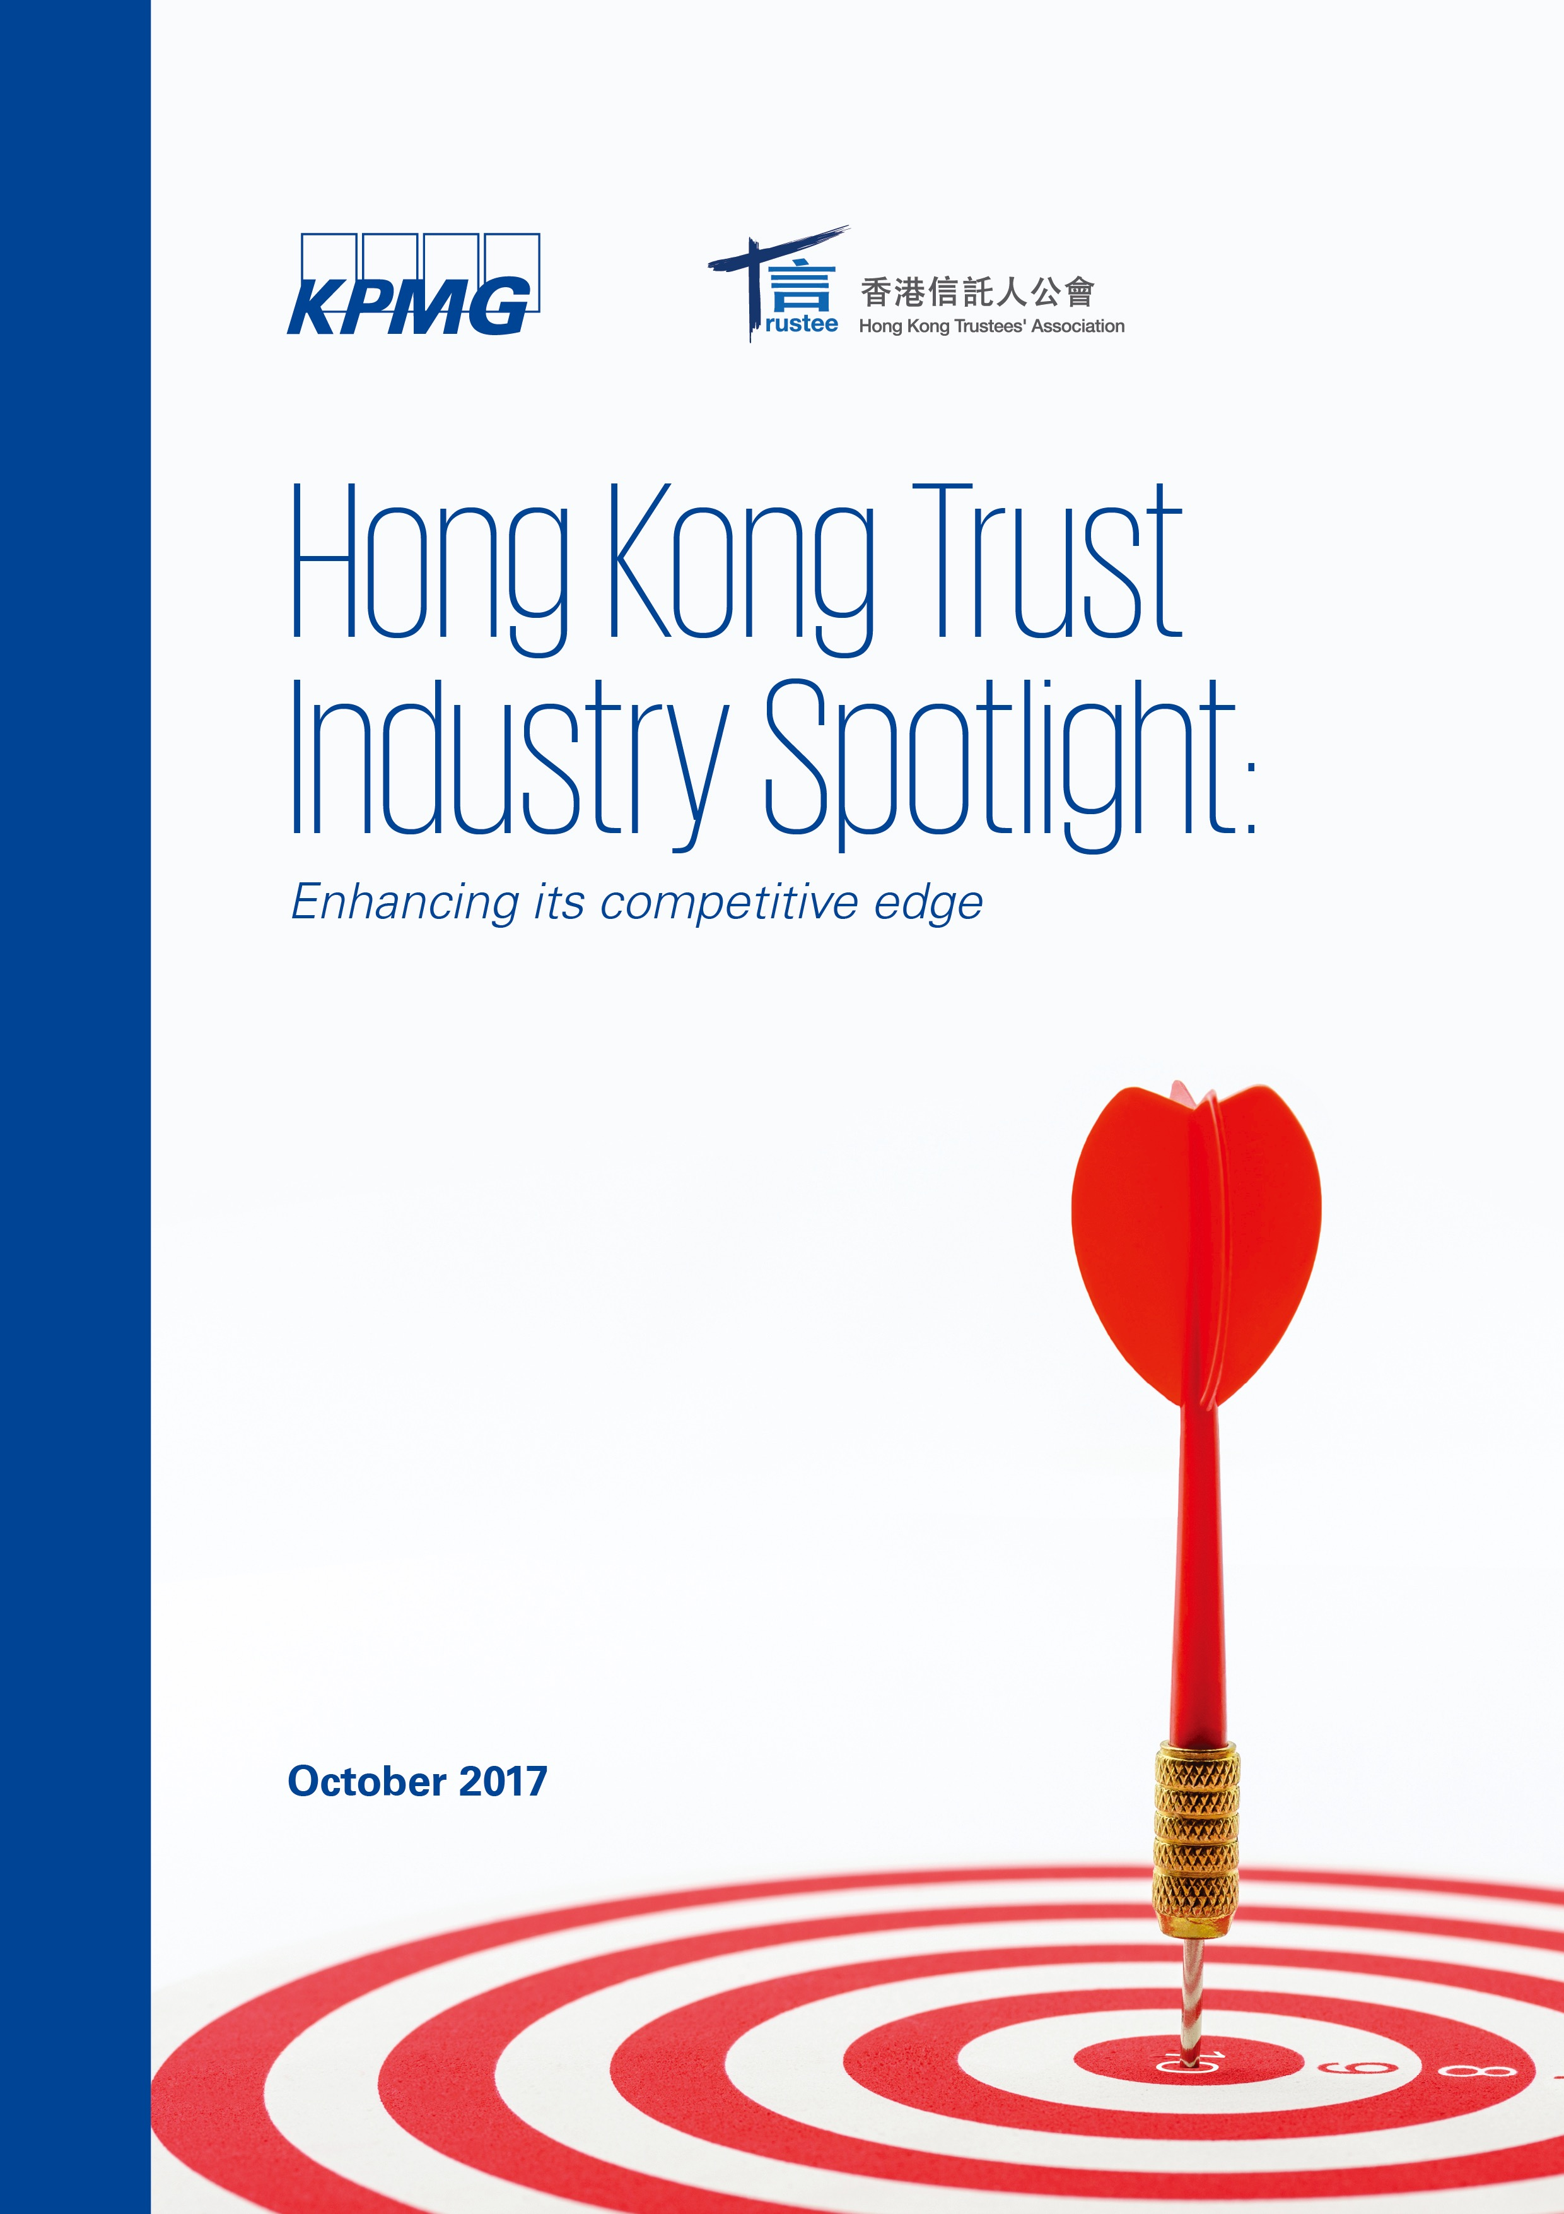
Hong Kong Trust Industry Spotlight
Four years since the inaugural report
Basis of our report:
Quantitative survey - 48 respondents
30 interviews with senior industry practitioners, government officials and regulators
Highlights of the report:
The compliance conundrum
Improving the talent pool
Streamlining of the regulatory framework
Clarity on tax

Slide 3
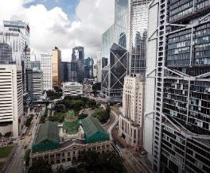
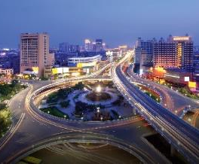
State of the Hong Kong trust industry
Pension
schemes
Corporate
trusts
Private
trusts
Charitable
trusts
DIS
Offsetting mechanism
eMPF
Investment restrictions
Enhanced governance structure
ETF
Mutual Recognition of Funds
OFC
Employee share plan
China
Family offices
VISTA / STAR-type trusts
Private trust companies
Competition
High net worth families
Charitable commission

Slide 4
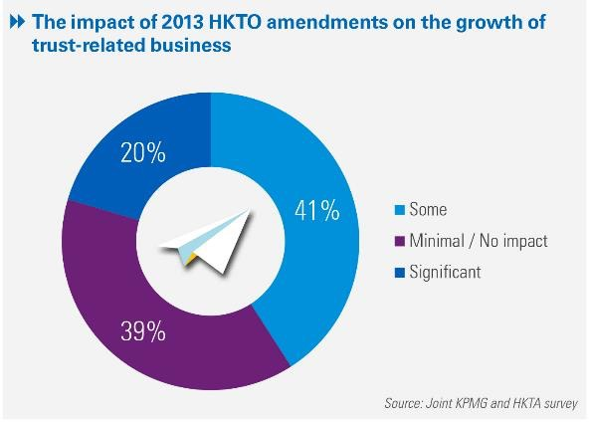
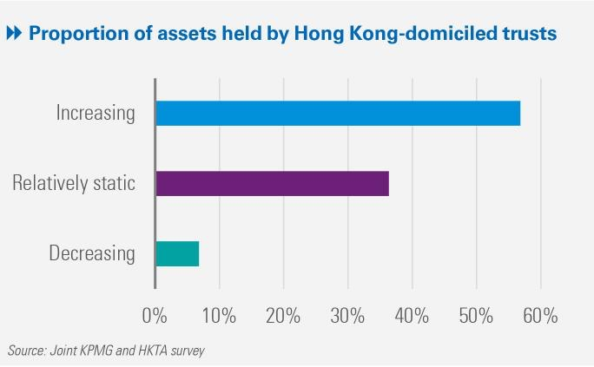
Impact of the HKTO amendments
Many industry participants agree that those statutory enactments have modernised Hong Kong’s trust regime and put the city back on the map as a key trust jurisdiction.

Slide 5
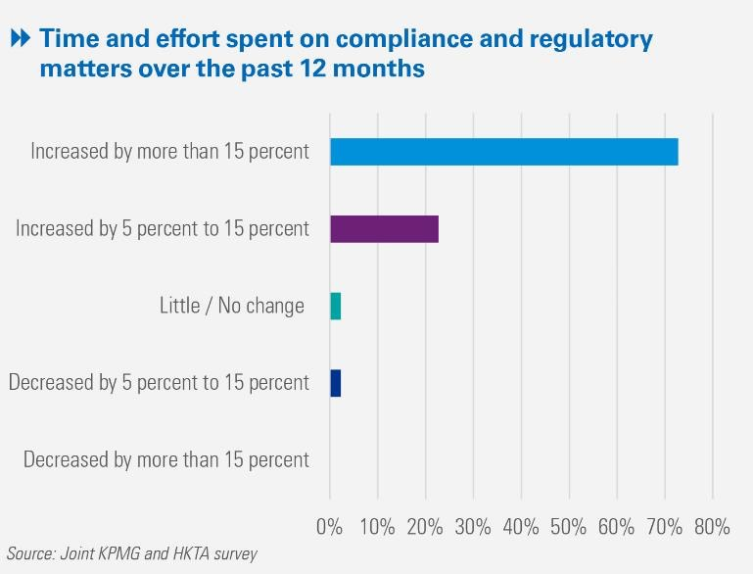
The Compliance Conundrum
Rising compliance costs is not a Hong Kong-specific issue, but a global trend that is likely to continue.
Many industry players are turning to technology to meet compliance obligations.

Slide 6
Improving the talent pool
1
HKTA Accreditation/Training Programme
2
Government’s Three-year Pilot Programme to Enhance Talent for the Asset and Wealth Management Sector
3
Other options for students and professionals to undergo trust-related training
4
Technology solution

Slide 7
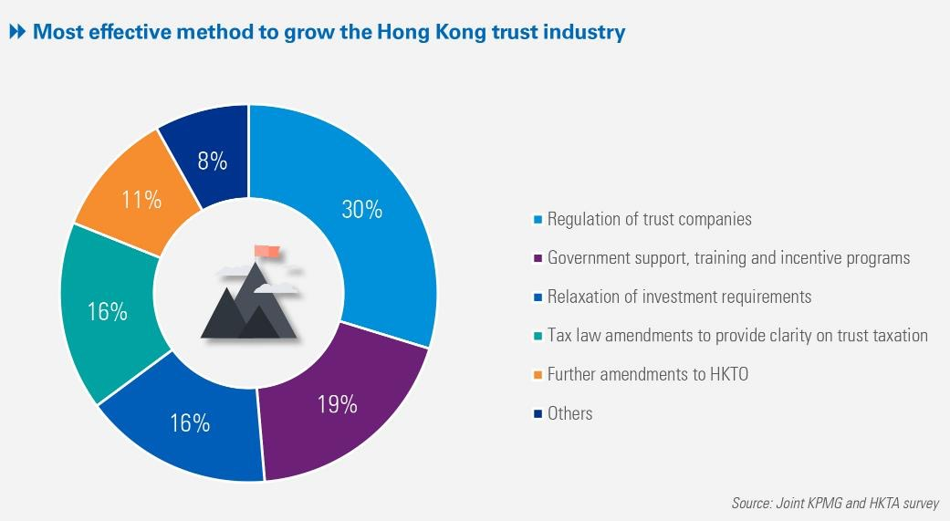
Streamlining of the regulatory framework
Streamlining of the regulatory framework would make it easier for
Hong Kong to create a vision for the trust industry, which would in turn contribute to the long term development of the market and enhance its international competitiveness.

Slide 8
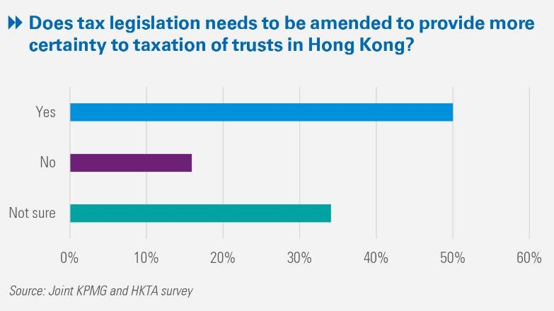
Clarity on tax
A trust has no separate legal personality and is not deemed a person
under section 2 of the IRO.
The general scholarly consensus is that trust profits falling within section 14 of the IRO
are chargeable to profits tax in the hands of the trustee.

Slide 9
Looking ahead
Talent development
Clarity on tax
Development of eMPF and enhanced governance structure
Guidelines for PTCs
Streamlining regulatory framework
Results oriented and hands on
Executive roles
VISTA / STAR-type trusts
Technology
Estbalishing a charities ccommission

Slide 10
Thank you

Slide 11
kpmg.com/cn/socialmedia
Intellectual property restriction
This document has been prepared specifically for the HKTA 2017 Conference. It contains confidential or proprietary KPMG information, the disclosure of which would provide a competitive advantage to others. It is not to be used or duplicated for any purpose other than to evaluate KPMG and is not to be disclosed or referred to, in whole or in part, without our prior written consent. The restriction pertains to all data throughout the entire document.
The information contained herein is of a general nature and is not intended to address the circumstances of any particular individual or entity. Although we endeavor to provide accurate and timely information, there can be no guarantee that such information is accurate as of the date it is received or that it will continue to be accurate in the future. No one should act on such information without appropriate professional advice after a thorough examination of the particular situation.
© 2017 KPMG, a Hong Kong partnership and a member firm of the KPMG network of independent member firms affiliated with KPMG International Cooperative (“KPMG International”), a Swiss entity. All rights reserved. Printed in Hong Kong.
The KPMG name, logo are registered trademarks or trademarks of KPMG International.

